Slide 1

South Brunswick High School
College Testing Night
Notes:
Welcome the audience, thank them for coming, introduce yourself.

Slide 2
AGENDA
What’s are these tests?
Strategies and sample problems
How The Princeton Review can help
TEXT YOUCAN TO 877877
to get a discount code and keep up-to-date on college admissions and testing
Notes:
Let them know they have hand outs for everything we will cover today so there’s no need to take pics of the PowerPoint slides. Refer to the handouts – hold them up and show them what they should have. Tell everyone to take out their phones and text YOUCAN to 877877. Wait for them to do it. Tell them they’ll get a discount code plus we’ll keep them up-to-date on all things test prep and college admissions!

Slide 3

WHAT ARE THE ACT & SAT?
Notes:
Admission tests provide broad comparative information to colleges. Admissions tests for colleges are kind of like clothing on your first date. It gives a quick picture of the person. It’s not 100% accurate, but it is a point of view. The better that initial impression, the better chance you have.
The SAT is offered 7 times a year however in 2017, it’ll be offered 8 times a year because they’re offering it in August, for the first time ever. And, in January 2017, it’s the last time the SAT will be offered in January. So for 2017 only, the SAT will be offered 8 times, not 7. It costs $43 to take, with the Essay (which we recommend) costs $54.50.
The duration is 3 hours, 50 minutes with the essay, which we highly recommend you taking. We’ll talk more about the essay later on.
Go through sections, cost and score range.
The average score is a 1090. This number was taken from the last reported mean, concorded to a new score.
Mean scores were: CR 495 M 511 W 484. When we put that into the college Board score converter (using 500, 510, 480)…the converted score is 1090 (EBRW = 550 and Math = 540).
(TAKEN FROM OUR WEBSITE - talk about the ACT the way you always talk about it to families)
What is the ACT and why is it important?
Created by ACT Inc., the ACT is an entrance exam used by most colleges and universities to make admissions decisions. The idea (in theory, at least) is to provide colleges with one common criterion that can be used to compare all applicants. The weight placed on ACT scores varies from school to school. Other important factors that schools consider in their admissions decisions are your high school GPA, academic transcripts, letters of recommendation, interviews and personal essays. For more specific information on the importance of ACT scores at the schools you're interested in, contact the admissions offices directly.
The ACT is offered nationally every year in September, October, December, February (not in NY), April and June. It’s 3 hours if you take it without the essay, and 3 hours and 40 mins with the essay. We HIGHLY RECOMMEND that students take the ACT with essay. The reason for this is if you end up applying to a school that requires you to take the ACT with essay, and you take it without the essay, you will need to take the ACT one more time with the essay in order to send that score to the college.
The cost is $34 (without essay) and $49.50 (with essay).
The score range is 1-36 and the national average is 21.
What specifically does the ACT test?
The ACT has four sections: English, Reading, Math and Science, as well as an optional 40-minute writing test. Some schools may require the writing test, so be sure to ask before you take it.

Slide 4


WHAT DO THESE TESTS MEASURE?
Admission tests.. | True | False
… measure intelligence?
… can be used to award aid?
… reflect your GPA in high school?
… predict your college GPA?
… can be prepared for?
… should be prepared for?
… test what you’ve learned in HS?
✓
Notes:
Add what it does not measure? It’s debatable whether or not it tests what you’ve learned in high school. On one hand, it tests algebra, grammar, etc. On the other, it tests it in a way that’s less familiar to you and much less straight forward. It’s also aggressively timed.

Slide 5

Who Takes the SAT & ACT?
High School Students!
Typically Junior Year or Early Senior Year
Historically SAT vs ACT Geographically Driven
Now more evenly distributed across the US*
  Accepted equally by basically every college
Class of 2017
  1.8 million SAT (1.7 million New SAT)¹
  2,030,038 ACT²
SAT & ACT Students and Products

Slide 6
Who Takes the SAT & ACT?
Students are:
  Busy and overscheduled
  Feeling pressure to apply to college
  Confused about what test to take
  May have strengths and weakness on the test
  May not understand why they are not scoring better on subjects they excel on in school
  May have general testing anxiety
SAT & ACT Students and Products

Slide 7
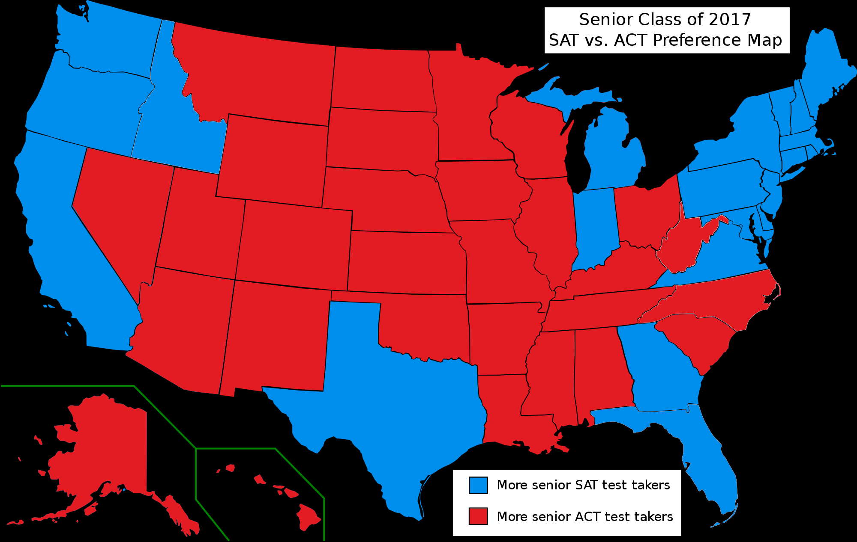
Who Takes the SAT & ACT?¹
SAT & ACT Students and Products
Notes:
So as I mentioned previously, there are geographica preference based on the more SAT students on the coast and more ACT students in the middle of the country.

Slide 8
WHAT IS ON
THE ACT & SAT?
Notes:
Let’s talk about what is on these tests…..

Slide 9

 | ACT ® | SAT
Format | Exclusively multiple choice | Mostly multiple choice
Content areas | English, Math, Reading, Writing, Science | Math, Reading, Writing
Scoring per section | 1 – 36 | 200 – 800
Timing | 2:55 (3:35) | 3:00 (3:50)
# of Questions | 215 | 154
TESTS
AT-A GLANCE
ACT is a registered trademark of ACT, Inc., which is not affiliated with The Princeton Review..

Slide 10
SAT SECTION-BY-SECTION
Reading | 65 minutes | 52 questions
W&L | 35 minutes | 44 questions
Math (No calculator) | 25 minutes | 20 questions
Math (calculator) | 55 minutes | 38 questions
Essay (optional) | 50 minutes | 1 essay
Total with Essay | 3:50 | 154 questions
Notes:
Go through section-by-section. Be sure to address that the total time does not include breaks.
Talk here about how long the test is, and how most students have NEVER taken a test this long before. Stamina, strategy and skill are important.

Slide 11
ACT SECTION-BY-SECTION
English | 45 minutes | 75 questions
Math | 60 minutes | 60 questions
Reading | 35 minutes | 40 questions
Science | 35 minutes | 40 questions
Writing (optional essay) | 40 minutes | 1 essay
Total with Writing | 3:35 | 215 questions
Notes:
Go through section-by-section. Be sure to address that the total time does not include breaks.
Talk here about how long the test is, and how most students have NEVER taken a test this long before. Stamina, strategy and skill are important.

Slide 12

SAT SCORING
MATH 200 – 800
EVIDENCE-BASED
READING AND WRITING 200 – 800
TOTAL 400 – 1600
ACT SCORING
ENGLISH 1-36
MATH 1-36
READING 1-36
SCIENCE 1-36
WRITING (ESSAY) 2-12
COMPOSITE 1-36
Notes:
The SAT has two sections – Math and Evidence-Based Reading and Writing (EBRW. You can earn a scaled score of between 200 and 800 points on each section, for a total of 1600 possible points on the SAT. (Address how the test changed in March of 2016 and it’s going back to its original scoring from days of yore).
What about all the other scores? Cross-Test Scores and Subscores?
This data is intended to help high schools assess college readiness and course advisement, but you should focus on your Total and Section scores.
How is the ACT scored?
You'll earn one ACT score (1 to 36) on each test (English, Math, Reading and Science) and a composite ACT score, which is an average of these four tests. Usually, when people ask about your score, they're referring to your composite ACT score. The composite score falls between 1 and 36. The national average is about 21. If, for example, you scored 31 on the English, 30 on the Math, 29 on the Reading and 30 on the Science, your composite ACT score would be 30.
Writing Test Scores (taken directly from ACT.org)
Taking the ACT with writing will provide you and the schools to which you have ACT report scores with additional scores. You will receive a total of five scores for this test: a single subject-level writing score reported on a range of 2-12, and four domain scores, also 2-12, that are based on an analytic scoring rubric. The subject-level score will be the rounded average of the four domain scores. The four domain scores are: Ideas and Analysis, Development and Support, Organization, and Language Use and Conventions. An image of your essay will be available to your high school and the colleges to which you have ACT report your scores from that test date.
Taking the writing test does not affect your subject area scores or your Composite score. However, without a writing test score, no English Language Arts (ELA) score will be reported.
Your essay will be evaluated based on the evidence that it provides of your ability to:
clearly state your own perspective on the issue and analyze the relationship between your perspective and at least one other perspective
develop and support your ideas with reasoning and examples
organize your ideas clearly and logically
communicate your ideas effectively in standard written English
Two trained readers will score your essay on a scale of 1-6 in each of the four writing domains. Each domain score represents the sum of the two readers' scores. If the readers' ratings disagree by more than one point, a third reader will evaluate the essay and resolve the discrepancy.
Sub scores are reported but not used in admissions process. Colleges care about composite score.

Slide 13

WHAT IS A GOOD SCORE?
Notes:
One of the questions I get most frequently is “what’s a good score?” Does anyone here know? (People will start calling out numbers). A good SAT score is a score that is going to help you get into your top-choice school.
For some students, that’s a 1090. For others, it’s a 1360.
Many schools offer scholarships based on SAT scores.

Slide 14
HIGH SCORES CAN LEAD TO
SCHOLARSHIP DOLLARS
SCHOOL | SAT* | ACT* | AVG. MERIT AWARD**
Santa Clara University | 1380 | 31 | $18,264
Dickinson College | 1350 | 31 | $16,952
University of North Carolina, Charlotte | 1270 | 29 | $16,455
Quinnipiac University | 1100 | 25 | $17,000
University of Maine | 1100 | 24 | $10,800
Saint Louis University | 1070 | 23 | $16,794
* SAT scores are reflective of the Critical reading and Math scores. The data is self-reported from the schools and represents data during the 2015-2016 school year. * ACT scores are self-reported from the schools and represent data during the 2015-2016 school year.
** Average merit award for qualifying individuals provided by schools.
Notes:
While the these tests are just one piece of the admissions puzzle, they have bigger implications. One thing I want you to understand is that schools often award scholarship dollars based on high scores. Here’s a sample of what was awarded last year to some students at these universities. These are minimum scores to qualify for merit aid and the merit amount is the average merit award per student.

Slide 15
Can scores improve?
Score Improvement with work
  SAT Prep with Khan Academy¹:
    0 hours = 60 point increase
    6 hours = 90 point increase
    20 hours = 115 point increase
  SAT Suite (PSAT 8/9, PSAT 10/11, SAT)²:
    30% of Juniors (Class of 2019) who took PSAT as Sophomores increased score by 100+ points
    34% of Seniors (Class of 2018) who took PSAT as Sophomores increased score by 100+ points
SAT & ACT Students and Products
Notes:
We at the Princeton Review have long believed that scores can be improved. It’s what our philosophy is based off of. We now have some support from college board, which is a bit ironic if you know the history of college board. For many years they claimed that much like an IQ test, you could not prep for the SAT. Well they recently did their own research with Khan Academy and these are the results they provided. I’m not sure what classifies as 0 hours of prep.
These suite of test are geared towards 8th, 9th and 10th grades, so showing you the improvement based on those test.

Slide 16
Should I Retest?
Score Improvement with retakes
  ACT¹
    45% took test multiple times
    57% improved score
Superscoring!²
  Schools will take the best individual section scores and combine them
  90% of schools superscore the SAT
  68% of schools superscore the ACT
Date | Verbal | Math | Total
October | 640 | 530 | 1170
December | 590 | 600 | 1190
Superscore! | 640 | 600 | 1240
SAT & ACT Students and Products
Notes:
So another question I’ll often receive from new students, or current studenst that are looking to improve. Well there is data that shows that scores increase when you retest. Improving your score is also going to require that you change and improve what you’re doing. .
Another reason to restest is for superscoring. Not ever school does this, but most of them do.

Slide 17

PREPARATION AND
PLANNING ARE KEY
Notes:
We’ve talked about when to take the test. Whether you take the SAT, ACT, or both, you should prepare.
The SAT (AND ACT) doesn’t show anything other than how well you take these tests – they’re skills based and you can learn these skills!
Regardless of whether you take the ACT, SAT, or both, you must prepare
Junior year is the most rigorous academic year:
AP Exams
SAT Subject Tests
Homework
Extracurricular Activities
The earlier you start planning, the better.

Slide 18
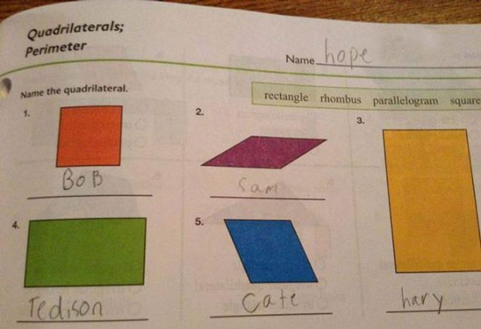
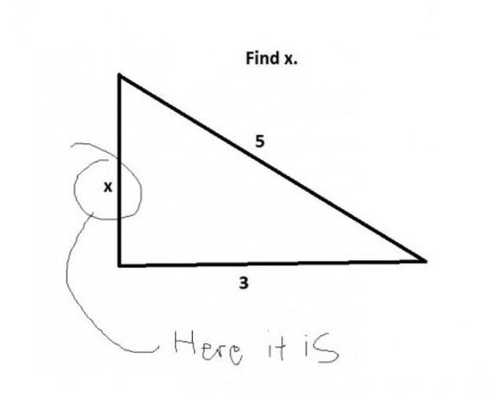
THESE TESTS REQUIRE TESTING SAVVY
Notes:
You need to be savvy in order to succeed on these tests. . Becoming test “savvy” requires knowing what is being asked, knowing the content, and developing an understanding of the tests.
(let the audience read these examples on their own – give them time to read and absorb the answers)
Well-written admission tests don’t allow this type of ambiguity of questions. But since most students have had questions like this since pre-k, taking standardized tests like the SAT and ACT require students to unlearn the habits of interpreting what a teacher actually meant by “find x”. Students have been conditioned over years of schooling and some of the habits you’ve learned are not easy to unlearn.
In these two examples given, the students answered the question and one could argue that the student is right. The SAT test writers would never use these types of questions because the questions are flawed and socialized, but we are used to these types of questions. When you see SAT questions, you may not understand why they look so complicated and weird. It’s important to understand that on the SAT, they’re being intentionally specific so that there’s no chance of you answering any of the questions like you see on this slide. Often times, this throws students for a loop.

Slide 19


PEOPLE ARE PREDICTABLE
COWS PRODUCE MILK
COWS DRINK WATER
Notes:
One of the most common things I hear from students is that “I’m a bad test taker” and from parents, “my son (or daughter) is a bad test taker”. I need you to know that you are not bad test takers. Never identify yourself that way. These tests have highly paid people writing questions to mislead you so that you get questions wrong. They know which wrong answer choices you’ll like, because high school students are predictable.
I’m going to throw 2 questions out at you. The first one you answer in your head. I’ll give you the question and you think of an answer in your head. Ready? Don’t shout it out. Everyone, pick a number. (Wait a few seconds). Got a number? Perfect. Whose number is over 5000? Over 1000? 100 to 500? Who chose a fraction, or a decimal? Whose number is between 1 and 10? (almost all hands should go up). Exactly. I gave you a broad question, but I know that I can funnel your answer down to a small scale. The people who make the PSAT, SAT and ACT know that also. So, that was an easy one, in your head.
Now I’m going to ask you two questions out loud and you need to shout out your answer.
First, what color is this board (if it’s a white board or hold up a white piece of paper and ask what color is this paper)? Okay. What do cows drink? (almost everyone will say milk) Milk, huh? No, cows don’t drink milk, unless maybe they’re baby cows. Cows drink water. But because I prepared you for my question, I was able to get you to answer what I wanted. Again, something the writers of the PSAT, SAT and ACT do quite a bit. If you struggle with these tests, it doesn’t mean you’re not a good test taker and it doesn’t reflect on your abilities academically. All it means is that people are designing a test and it’s working the way it’s supposed to. But, because they’re using strategies to trick you, it’s what makes strategies to unlock the test so powerful. The Princeton Review believes that you can crack these exams. It takes skill, and we can help you build that skill. There’s a language to these tests and once you learn it, you can excel more than you thought possible.
We pride ourselves on being the answer to all life’s tests. Whether it’s SAT, ACT or down the road you’re trying to get into medical school. We can help you prepare for all of these exams.

Slide 20
TEST WRITERS EXPECT YOU TO RESPOND IN A PREDICTABLE WAY
  If a store raises the price of an item by 20%, then decreases the new price by 15%, what was the percent change in the price of the item?
Notes:
The trap answer is a 5 percent change! The real answer is 2%
(go through the math….item is $100 and it’s raised 20% which is $20. New price = $120. Then $120 is decreased 15% which is $18. $120-$18 = $102. Which is 2% increase)

Slide 21


STRATEGY: SAT PACING
540
26 correct
58 attempted
32 incorrect
26
0
5
10
15
20
25
30
35
40
45
50
55
58
610
580
38 attempted: 30 correct
+4
20 guesses
30
34
0
5
10
15
20
25
30
35
40
45
50
55
58
Notes:
Understanding and conveying pacing strategies helps foster stronger test takers. It’s one of the things we teach at The Princeton Review. Notice on the SAT, 58Q, The bunny (fast) attempts every questions and is very inaccurate – 26 correct, 32 incorrect.
The turtle (slow and steady wins the race) takes his time, aims for accuracy and does not even attempt all questions. The turtle guesses a random Letter of the Day on the last 20 questions. You should never leave an answer blank on the SAT. With more time per questions, Turtle does not make careless errors because he has much more time per questions. Turtle gets 30 correct - plus on the 20 guess, he gets another 4 correct (34 total correct).
Comparing scores, Bunny gets a 540 and Turtle gets a 610. That’s a big difference. You can get more points by answering fewer questions! The key here is that you need to get those questions CORRECT.

Slide 22
20
30 correct
60 attempted
30 incorrect
30
ACT PACING
0
5
10
15
20
25
30
35
40
45
50
55
60
24
22
45 attempted: 35 correct
+3
10
incorrect
15 guesses
35
38
0
5
10
15
20
25
30
35
40
45
50
55
60
Notes:
Understanding and conveying pacing strategies helps foster stronger test takers. It’s one of the things we teach at The Princeton Review. Notice on the ACT, 60 questions, The bunny (fast) attempts every question and is very inaccurate – 30 correct, 30 incorrect.
The turtle (slow and steady wins the race) takes his time, aims for accuracy and does not even attempt all questions. The turtle guesses a random Letter of the Day on the last 15 questions. With more time per questions, Turtle does not make as many careless errors because he has much more time per question. Turtle attempts 45 questions and gets 35 correct, plus on the 15 guess, he gets another 3 correct (38 total correct).
Comparing scores, Bunny gets a 20 and Turtle gets a 24. That’s a big difference. You can get more points by answering fewer questions! The key here is that you need to get those questions CORRECT.

Slide 23

THE RIGHT COACH
MAKES ALL THE DIFFERENCE
Notes:
One of the biggest points I want you to take away from me today is that THESE TESTS REQUIRE SKILL and WE CAN TEACH YOU THIS SKILL. Every day, I talk to parents and students who are confused by the fact that despite being an excellent student, they’re not doing well on these tests. With the right coach and training, you can learn to ace these tests. These exams are coachable.

Slide 24
THE RIGHT PREP
MAKES ALL THE DIFFERENCE
Notes:
Good test prep teaches:
Familiarity with the test
Common traps and how to avoid them
Confidence
Go through common mistakes we see.
Common mistakes:
Answering questions too quickly
Careless errors
Doing work in your head
Misreading the problem
Don’t understand what to do

Slide 25
Princeton Review Methods
ACT SAMPLE PROBLEM
10
If Claire is C years old and is 6 years younger than Alan,
in terms of C, how old will Alan be in 3 years?
16
19 Target Answer
10
C-6
C-3
C+3
C+9
=
=
=
=
4
7
STRATEGY: PLUGGING IN
13
19

Slide 26
SOPHOMORES: PREP SUMMER BEFORE JUNIOR YEAR
Summer between sophomore and junior year
SeptemberACT
October
PSAT
December
ACT
June
SAT
ACT focus
PREP
PREP
PREP
Summer Fall Winter Spring Summer
Summer between sophomore and junior year
August
SAT
October
PSAT
December
SAT
June
ACT
SAT focus
PREP
PREP
PREP
Summer Fall Winter Spring Summer
Notes:
Start prepping in the summer between sophomore and junior year! Get one test out of the way early in your junior year.
Don’t take the test(s) lots and lots of times, because many schools will want you to send ALL scores. This is a good reason to be prepared when you take it.
Choose a test and begin to prepare for that test. Switch tests if necessary and wanted. WALK THROUGH THIS TIMELINE, ADDRESSING AP EXAMS.
NY STATE: SWITCH FEBRUARY TO APRIL ACT.
One of the most common questions we at The Princeton Review get is, “When should I take the test?” Our answer is: you should take the test when you’re prepared for the test, When you’ve studied in earnest and when you’re 100% ready for the test.
The ACT is given 6 times per year (except in NY where it’s not given in February) and the SAT is historically given seven times a year. 2017 will be a bit different though. In 2017, the SAT will be administered eight times. It’s going to be administered for its last January administration this January. And College Board is adding an August administration date.
For sophomores, we recommend that you begin preparing for these exams in earnest, the summer between sophomore and junior year. In 2017, you’ll have the opportunity to take the SAT in August, which is a big win for you! You’ll have much more time in the summer to prepare for the SAT, and traditionally, when students prepared for the SAT in the summer, they had to wait until October to take the test. Not anymore. You can take the August SAT and be done prepping and you’ll have one test under your belt before school starts. ← (IF YOUR SCHOOLS GO BACK IN AUGUST, CHANGE THIS MESSAGE A BIT). You’ll get one out of the way so that you may start your junior year off without having to add in test preparation on top of all the academics.

Slide 27
JUNIORS: PREP AS EARLY AS POSSIBLE
October PSAT
February
ACT
April
ACT
August
SAT
ACT focus
PREP
PREP
PREP
Fall Winter Spring Summer Fall
prep
October PSAT
March
SAT
June
SAT
September
ACT
SAT focus
PREP
PREP
PREP
Fall Winter Spring Summer Fall
Notes:
Start planning early. Choose a test and begin to prepare for that test. Switch tests if necessary and wanted. WALK THROUGH THIS TIMELINE, ADDRESS AP EXAMS IN MAY – we want to avoid May if possible.
NY STATE: SWITCH FEB to DECEMBER AND KEEP APRIL.
One of the most common questions we at The Princeton Review get is, “When should I take the test?” Our answer is: you should take the test when you’re prepared for the test, When you’ve studied in earnest and when you’re 100% ready for the test.
The ACT is given 6 times per year (except in NY where it’s not given in February) and the SAT is historically given seven times a year. 2017 will be a bit different though. In 2017, the SAT will be administered eight times. It’s going to be administered for its last January administration this January. And College Board is adding an August administration date. This is great news for both sophomores (who will be rising juniors in the summer of 2017) and juniors (who will be rising seniors in the summer of 2017).
For juniors, we always recommend that you start your preparation as early as possible in your junior year. Some of you juniors may have already prepared for one or both of these tests this summer, and you’ll take one or more fall exams. Some of you may have already taken an SAT or ACT! Some of you are not sure when to get started…but believe me, the spring of your junior year gets absolutely crazy with exams and if you’re takin APs you should not even consider taking the SAT in May. If you’re a junior, we recommend you start preparing and taking these tests EARLY, which means NOW. Find a time frame that allows you to be the most successful in terms of preparing properly without being too busy. You should consider preparing this fall and taking a fall or winter exam, so you can focus on your studies and extracurricular activities in the spring.

Slide 28



GETTING INTO COLLEGE IS ABOUT MORE THAN TEST SCORES
GREAT TEST SCORES
GREAT APPLICATIONS
GREAT GRADES
Z
3.8
1450
Notes:
We’ve spent a lot of time talking about the ACT and the SAT, and it’s just one piece of the puzzle. Getting into the school of your dreams includes three key elements:
Great grades and great applications play a role, too. I'm going to spend some time talking to you about how we can help you strengthen each part of your application.
It’s not one or the other – it’s all three working together

Slide 29


TEST PREP WITH OPTIONS FOR EVERY SCHEDULE
AND BUDGET
Notes:
We’re with you all the way with our test preparation programs. The Princeton Review has been helping students improve standardized test scores for more than 30 years. Taking these tests require skill, and it’s something you can learn. We’ve got options for every budget and every schedule, from an online self-paced program to one-on-one private tutoring.
The two pictures you see here were taken from video lessons on The Princeton Review Online Student Portal. Your online student portal is filled with additional tests and drills for you to practice outside of your class. These are actual teachers, teaching real lessons, who walk you through concepts. This is just one part of the Online Student Portal, which you get as part of being part of The Princeton Review family.

Slide 30
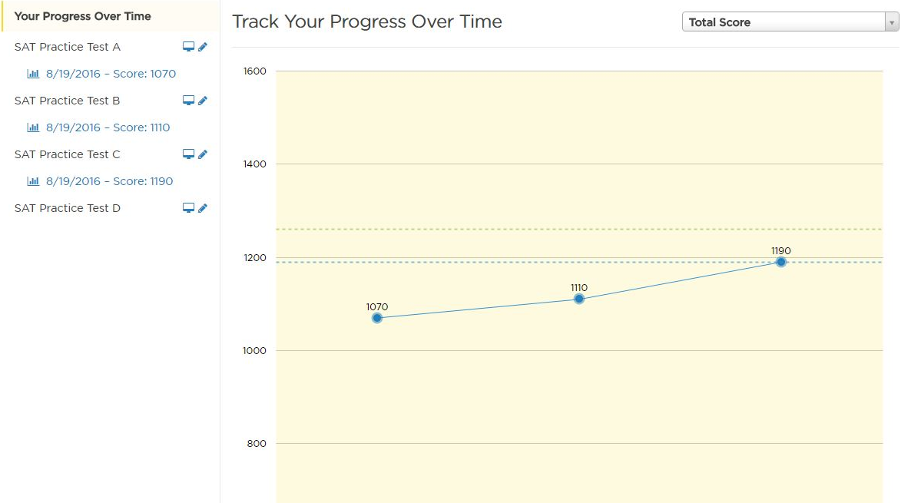

Notes:
You’ll be able to track your tests and improvement by using our Online Student Portal, which provides personalized recommendations that show you where to focus your attention to efficiently manage your time and maximize your score potential

Slide 31
PROGRAM ELEMENTS | The Princeton Review Self-Paced | Khan Academy
Practice questions | Yes | Yes
Video lessons | Yes | Yes
Test-taking strategies | Yes | No
Focus on score improvement | Yes | No
Recommendation Engine | Yes | No
Live on-demand 1-on-1 help | Yes | No
Notes:
There are lots of free practice tools available in the marketplace that are great. But there is a difference between practice and preparation.
It’s about the investment you put in and what you get out of your program – and the investment does not need to be significant. Take our self paced program for example.
When you look at self paced vs Khan:
We both offer tons of practice questions,
We both offer video lessons, but there is a difference in how they are presented. In Khan’s video, you see the problem or hear a full passage and watch him work through the details to get to the right answer. The videos can be a bit long, and are honestly a bit dry. At TPR, we have short 3-5 minute videos where our instructors teach you to crack the problem in a fun and engaging way, while applying strategies to get to the right answer faster.
In addition to teaching you the content, we focus on teaching you the strategies to maximize your score improvement. As we discussed earlier, this test is coachable, and strategies are a key component. It’s not enough to just know the content. What is equally important is to have strategies like pacing – remember earlier I showed you that you can get more points by answering fewer questions? That’s an important strategy that students need to know. We teach you many valuable strategies while Kahn primarily focuses their attention on the content. Content can be helpful but without strategy to go along with it, it’s not as efficient.
We also have a recommendation engine as part of our online student portal, which tracks your performance as you advance through the class and provides personalized recommendations on where to focus your attention to ensure on score maximizing opportunities.
THE DIFFERENCES BETWEEN OUR RECOMMENDATION ENGINE AND KHAN’S “PERSONALIZED RECOMMENDATIONS”:
Khan’s recommendations are based on connecting the student account to collegeboard.org to import/see real test scores, and diagnostic quizzes. Those recommendations then drive students to drills.
TPR’s RE is based on either a full-length test, or, failing that, a mini diagnostic. It’s also based on all new input from assessments as students go—every test or drill they take will immediately inform/sharpen our recommendations.
Our RE then uses a proprietary algorithm to create a recommendation for learning and practice that factors in not just a student’s performance in a skill area, but also the relative importance of that skill to others.
It’s also worth noting that Khan appears to recommend ad infinitum, whereas we recommend exactly what the student needs to work on, and only those things.
And finally, we exclusively offer 3 hours of live one-on-one help. Stuck on something? Just select chat with a teacher and we immediately connect you with a live teacher who will provide the individualized help you need to understand the concept.

Slide 32
HOMEWORK HELP AVAILABLE 24 / 7
40%
96%
STUDENTS IMPROVED THEIR GRADES.*
5,000 students get help every night from The Princeton Review.**
40 subjects covered
***
3,000 tutors - from teachers to Ph.D.s
BETTER GRADES. GUARANTEED.
Try a free session tonight
* Based on 2014 survey of students of The Princeton Review/Tutor.com
** Based on average annual school night sessions on Princeton Review/Tutor.com
*** Visit PrincetonReview.com/Guarantee for details
Notes:
I want to talk a little bit more about earning great grades in high school. You build your academic record over four years and EVERYONE in this room can benefit how The Princeton Review can help here.
What’s one of the most stressful things about High School, aside from the exams Something that you agonize over each night? (WAIT FOR THE ANSWER)…..yes, it’s HOMEWORK. “Homework Help” is something The Princeton Review has been helping students with for more than 18 years, and we’ve really revolutionized the way we work with students to help them improve their grades. We offer real-time help to students who are struggling with homework, 24 hours a day, 7 days a week. Picture this, parents: your child is struggling with a Calculus homework question at 10pm, and you have no clue what the difference is between limits, functions, derivatives or integrals. Instead of listening to your agonizing child struggle, go to princetonreview.com sign up up for a free session! Each night we help 5,000 students with their homework online and we guarantee that if you work with our tutors for at least two hours a month for three consecutive months, you will see an improvement in your grade in the subject we are helping you with. It’s a no-brainer so take advantage of your free session tonight as you’re doing homework!

Slide 33
THE PRINCETON
REVIEW IS #1 AT
GETTING STUDENTS
INTO TOP COLLEGES**
4 OUT OF 5
Princeton Review
students get into their top-choice school.*
*Based on a 2015 Princeton Review survey of parents of students enrolled in 4-year colleges
** Based on a 2015 Princeton Review survey of over 1,000 students enrolled in 4-year colleges
and U.S. News & World Report national ranking for Universities and Liberal Arts Colleges
Notes:
Our program works and we have thousands of success stories across the country. Our goal is to help you get your highest score possible by teaching you the skills and strategies to score high on these tests. We liken preparing for these tests to running a marathon - you wouldn’t wake up one morning and run 26.2 miles without the proper training. You need to train for this test – it’s a test which requires endurance. You don’t take four-hour exams in high school and you need to practice, practice, practice. And our results speak for themselves (go through results).
Better yet, our program is guaranteed – if you work with us, we guarantee you’ll see a score improvement or your money back.

Slide 34

YOU CAN GET THE SCORE YOU WANT
WE’RE HERE TO HELP

Slide 35
QUESTIONS?
Nicole Iannucci
Nicole.Iannucci@review.com 848-229-9978 (direct line)
princetonreview.com & 800-2REVIEW
TEXT YOUCAN
to 877877
to get a discount code and keep up-to-date on college admissions and testing
/ThePrincetonReview
@ThePrincetonRev
ThePrincetonReview
©2016 TPR Education IP Holdings, LLC. All Rights Reserved. Test names are the registered trademarks of their respective owners, who are not affiliated with The Princeton Review.

